Slide 1

POUR one out for A11y
The 4 Principles of WCAG
Month 20XX

Slide 2

What is A11Y?
A numeronym for the word Accessibility.
Accessibility – “…word used to describe whether a product can be used by people of all abilities.” – Microsoft Accessibility Fundamentals
Disability – “…a mismatch in interaction between the features of a person’s body and the features of the environment in which they live.” – Microsoft Accessibility Fundamentals
Assistive Technology – “…any item, piece of equipment, software program, or product that is used to increase, maintain, or improve the functional capabilities of people with disabilities.” – Assistive Technology Industry Association

Slide 3

What is WCAG?
Web Content Accessibility Guidelines
Published by the Web Accessibility Initiative (WAI) of the World Wide Web Consortium (W3C) in 1999.
WAI is also responsible for the WAI-ARIA (Accessible Rich Internet Applications) technical specification.
Help us make digital content more accessible.
The foundation of most Accessibility regulations.
Notes:
“WAI-ARIA is a technical specification written by the World Wide Web Consortium (W3C). The specification is most commonly used by developers to build interactive website content that is accessible to people with disabilities.”” – Siteimprove

Slide 4
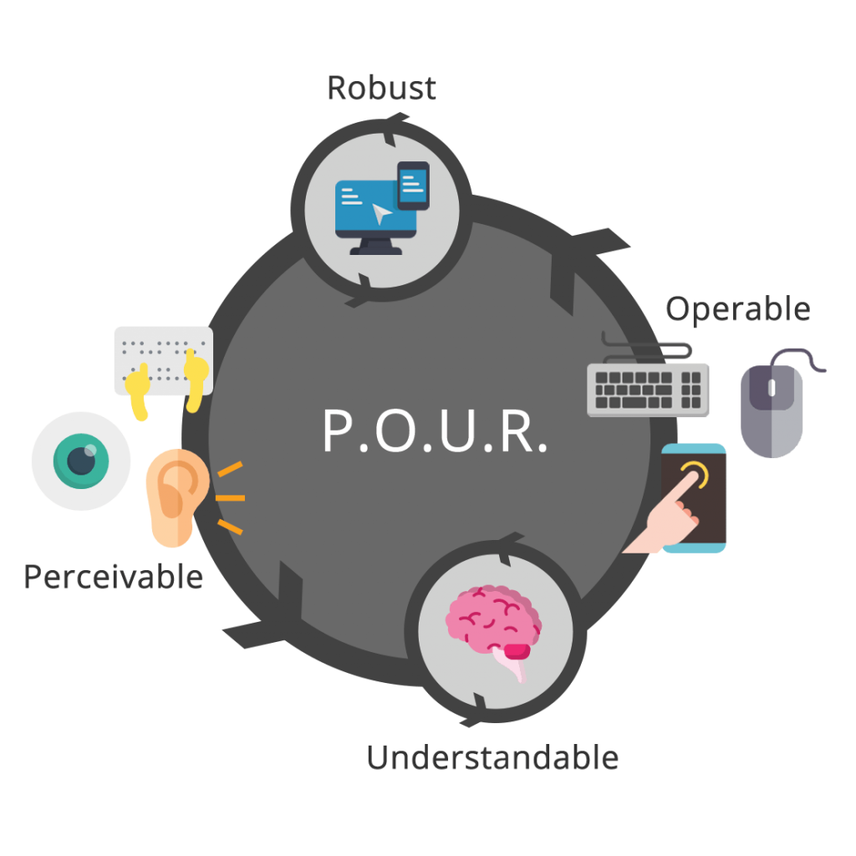
What is POUR?
The 4 core principles of WCAG.
Stands for Perceivable, Operable, Understandable, and Robust.
These are further divided up into 13 guidelines as of WCAG 2.1.
The guidelines are further defined using a set of success criterion, which help determine level of conformance (A, AA, or AAA).

Slide 5

Perceivable
Information and user interface components must be presentable to users in ways they can perceive.
Guideline 1.1: Text Alternatives: Provide text alternatives for any non-text content so that it can be changed into other forms people need, such as large print, braille, speech, symbols, or simpler language.
Guideline 1.2: Time-based media: Provide alternatives for time-based media.
Guideline 1.3: Adaptable: Create content that can be presented in different ways (for example simpler layout) without losing information or structure.
Guideline 1.4: Distinguishable: Make it easier for users to see and hear content including separating foreground from background.

Slide 6

Operable
User interface components and navigation must be operable.
Guideline 2.1: Keyboard Accessible: Make all functionality available from a keyboard.
Guideline 2.2: Enough Time: Provide users enough time to read and use content.
Guideline 2.3: Seizure and Physical Reactions: Do not design content in a way that is known to cause seizures.
Guideline 2.4: Navigable: Provide ways to help users navigate, find content, and determine where they are.
Guideline 2.5: Input Modalities: Make it easier for users to operate functionality through various inputs beyond keyboard.

Slide 7

Understandable
Information and the operation of user interface must be understandable.
Guideline 3.1: Readable: Make text content readable and understandable.
Guideline 3.2: Predictable: Make web pages appear and operate in predictable ways.
Guideline 3.3: Input Assistance: Help users avoid and correct mistakes.

Slide 8

Robust
Content must be robust enough that it can be interpreted reliably by a wide variety of user agents, including assistive technologies.
Guideline 4.1: Maximize compatibility with current and future user agents, including assistive technologies.

Slide 9

THANK YOU!
Erissa Gray
Home Page:
https://corgidev.com
Twitter & Twitch:
@TheCorgiDev
LinkedIn, Instagram, & GitHub
@CorgiDev

